Slide 1
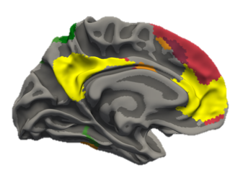
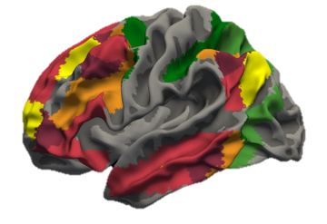
Contributions of Frontoparietal Control Network to Abstract Reasoning
Tom Morin
GPN Retreat 2019
Notes:
Raven’s picture… diff title depending on where I am

Slide 2
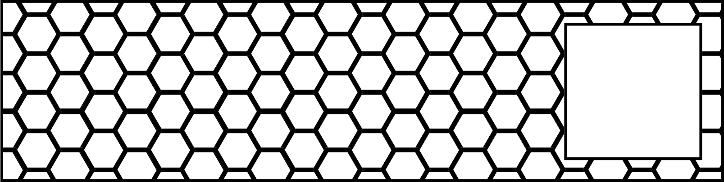
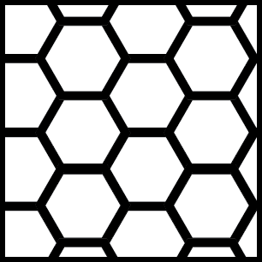
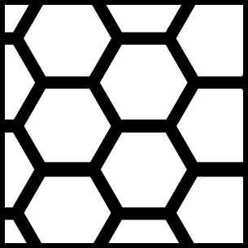

Slide 3




Slide 4
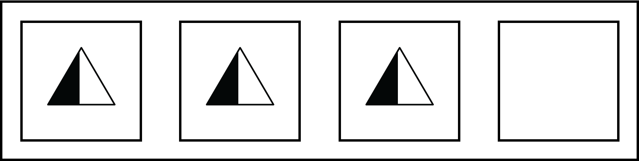



Slide 5
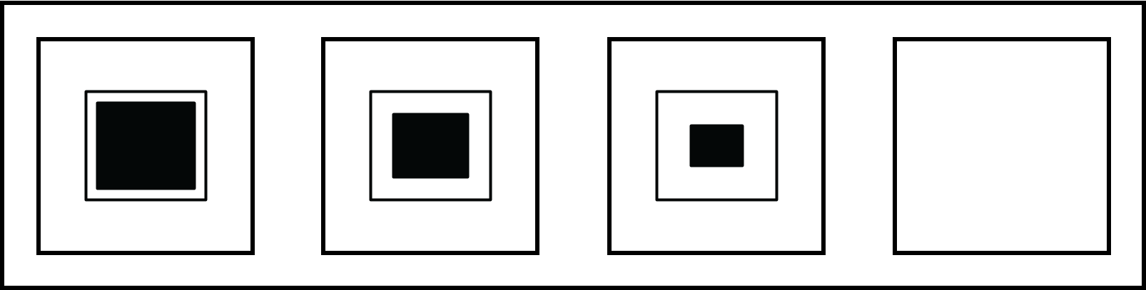

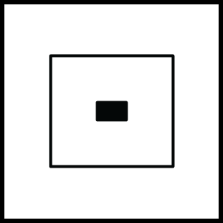

Slide 6
Raven’s Progressive Matrices Task
Neuropsychological test of:
Fluid Intelligence
Relational Reasoning
Symbolic Processing
Several Problem Types:
Notes:
Elaborate more? Mention that the test is used for aging studies, children developmental, etc.
Neuropsych test of “intelligence and reasoning”
Bracket under textures: “Perceptual Reasoning”… “symbolic reasoning”

Slide 7
Previous Work on the Raven’s Progressive Matrices Task
Computational Models
Carpenter, Just, & Shell (1990)
Kunda, McGreggor, & Goel (2013)
Rasmussen & Eliasmith (2011, 2014)
Lovett & Forbus (2017)
Raudies & Hasselmo (2017)
Hasselmo (Preprint, 2018)
fMRI Studies
Prabhakaran et al (1997)
Christoff et al. (2001)
Melrose, Poulin, & Stern (2007)
Golde, Cramon, & Schubotz (2010)
Notes:
Texture as contiguous and symbol as discrete…. Harder to model contiguous stuff?

Slide 8
Frontoparietal Activity Contributes to Relational Reasoning
Common Modelling Approach:
Deduce the visuospatial relationship between stimuli (Parietal)
Apply that rule to simulate what comes next (Prefrontal)
Golde et al. 2010
Genovesio, Wise, & Passingham; 2014
Notes:
Instead of relationship: “rule”

Slide 9
Motivation
Question:
How does perceptual reasoning (texture stimuli) differ from symbolic reasoning (symbol stimuli)?
Hypothesis:
Both types of reasoning recruit frontoparietal regions.
Perceptual reasoning may also bring in ventral visual regions.
Notes:
Maybe ways to extend the hypothesis … include network stuff

Slide 10
Task Conditions

Slide 11
Sample Trial
N=27
396 Trials per Participant

Slide 12
Activity During Symbolic and Perceptual Reasoning
Symbol Rule
>
Symbol Uniform
Texture Rule
>
Texture Uniform

Slide 13
Key Differences Between Symbolic and Perceptual Reasoning Activity

Slide 14
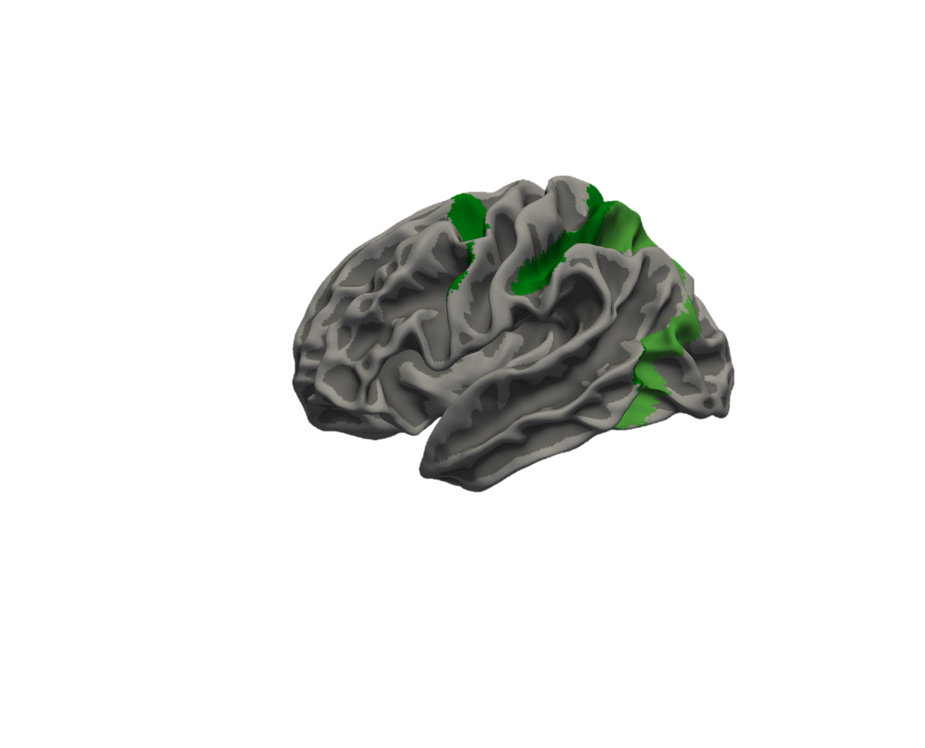
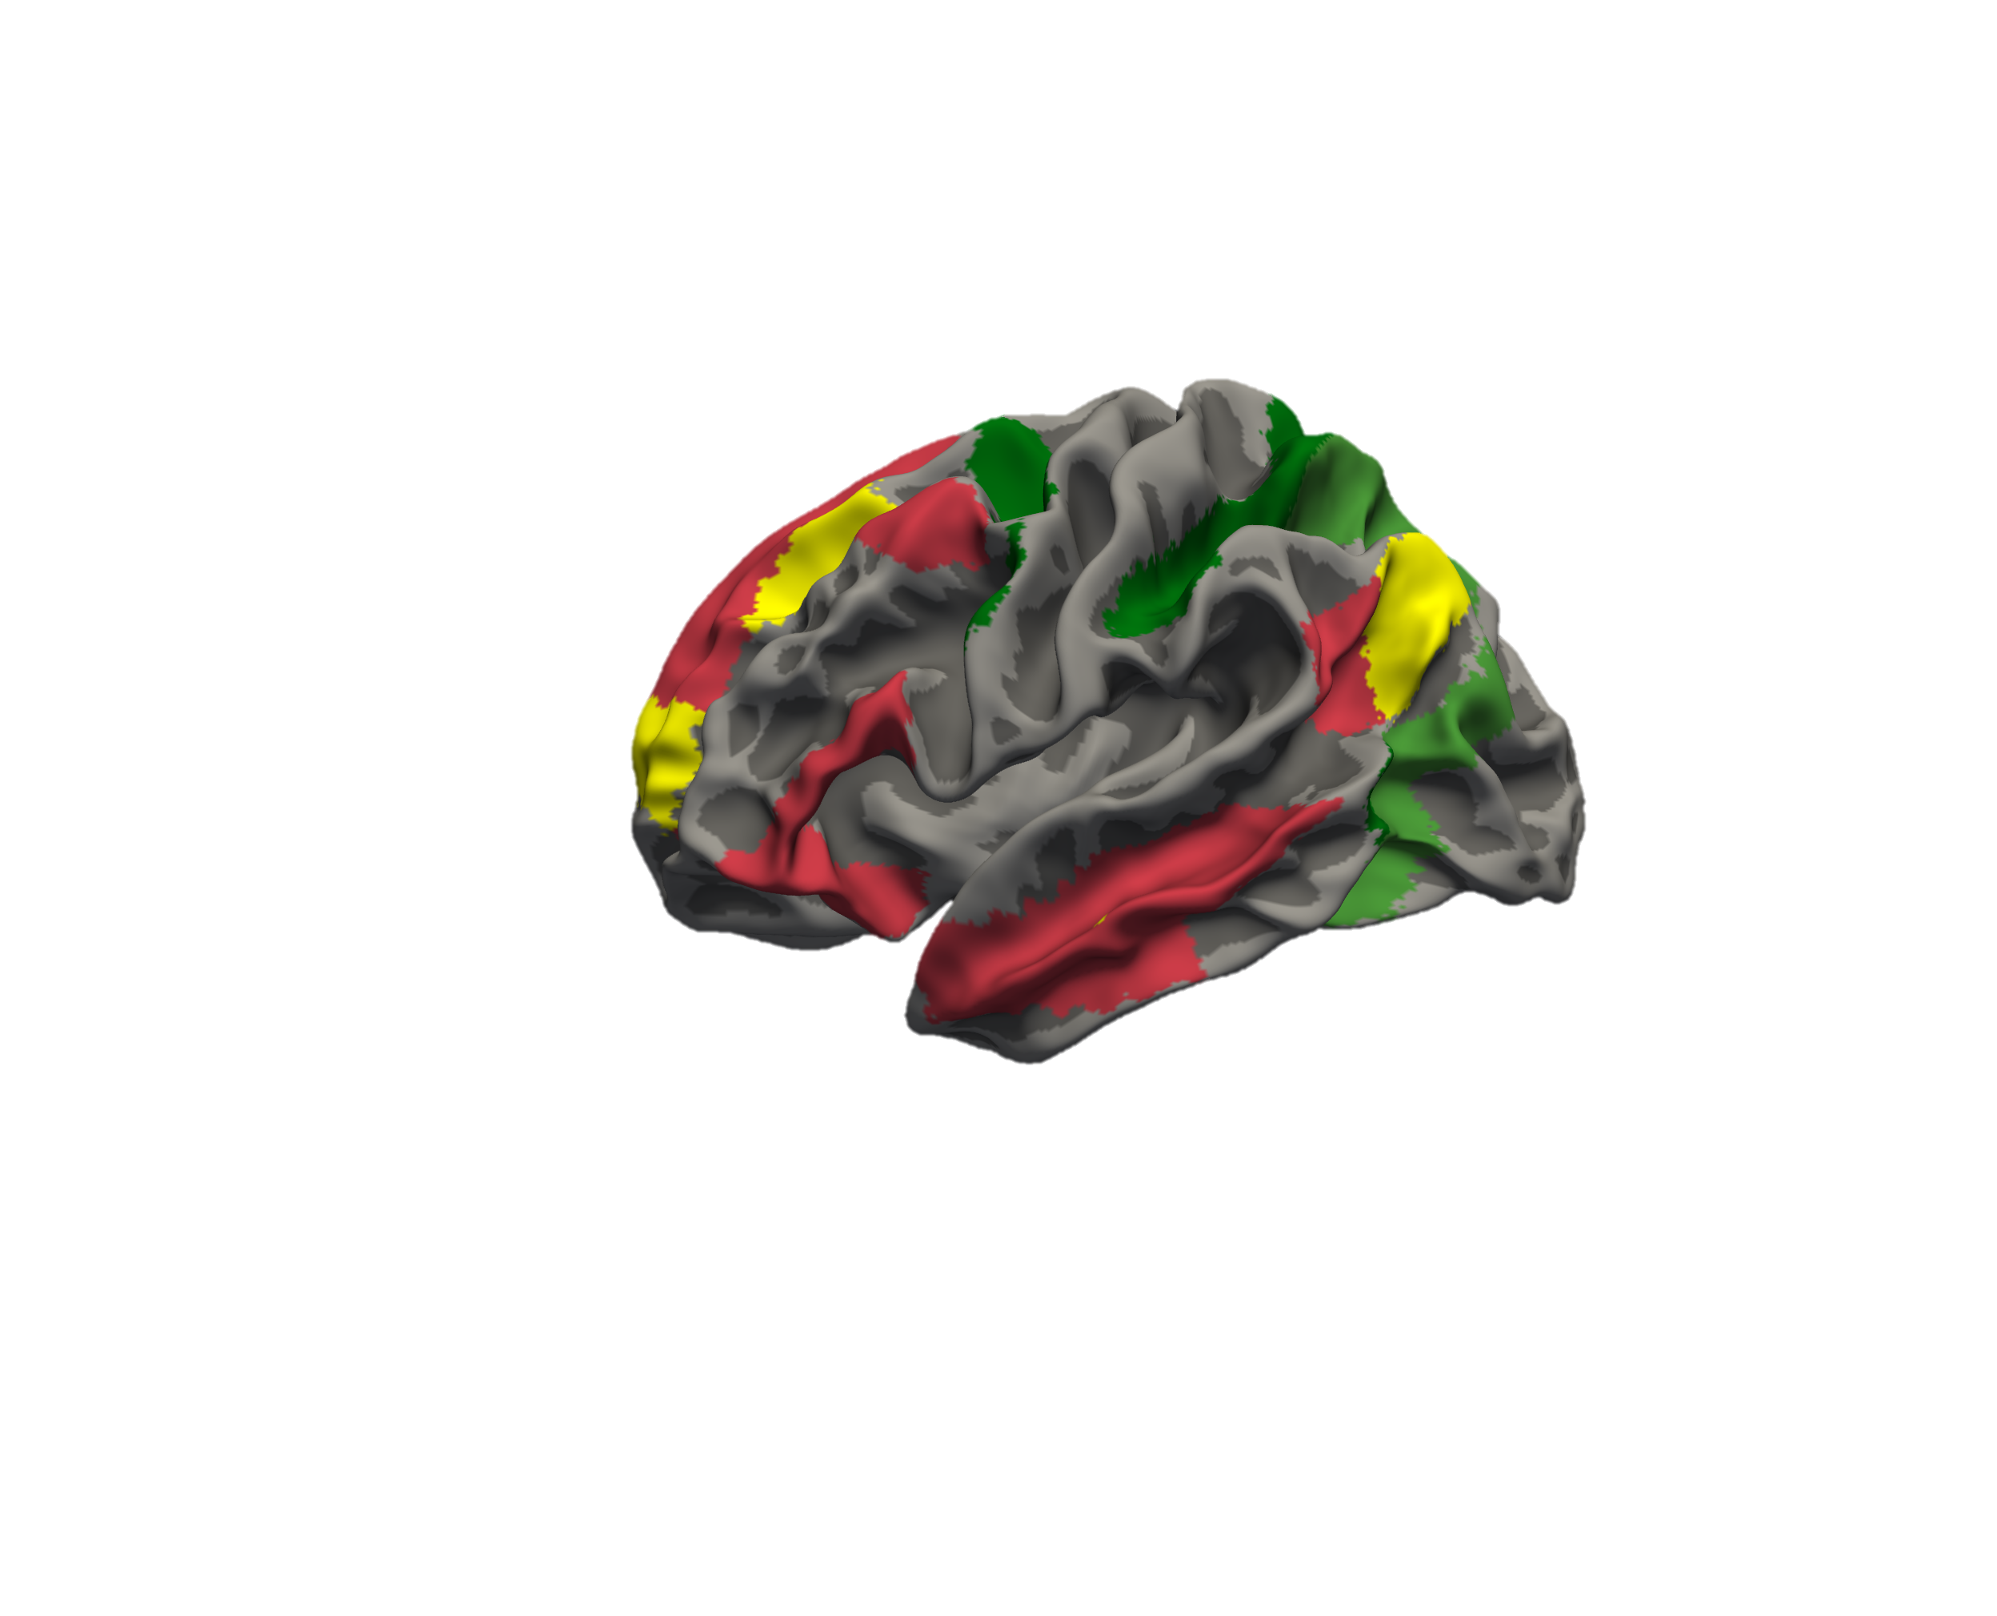
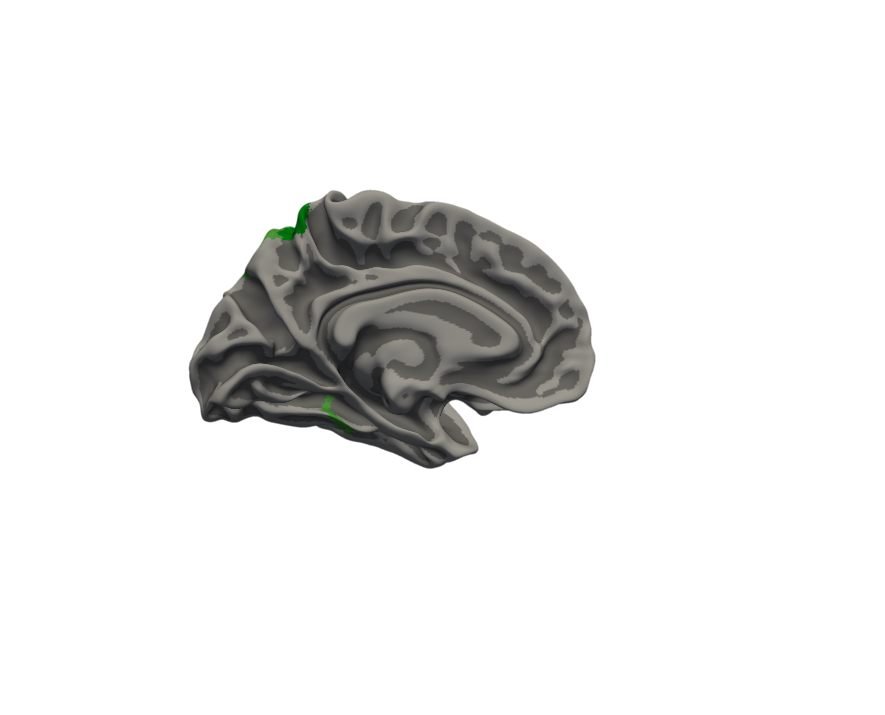
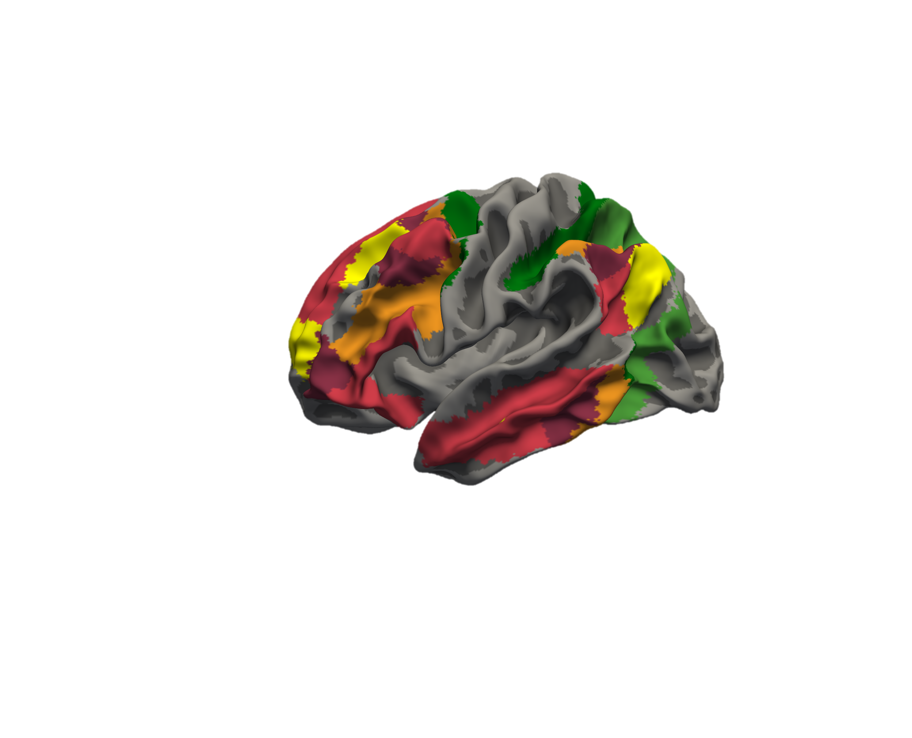
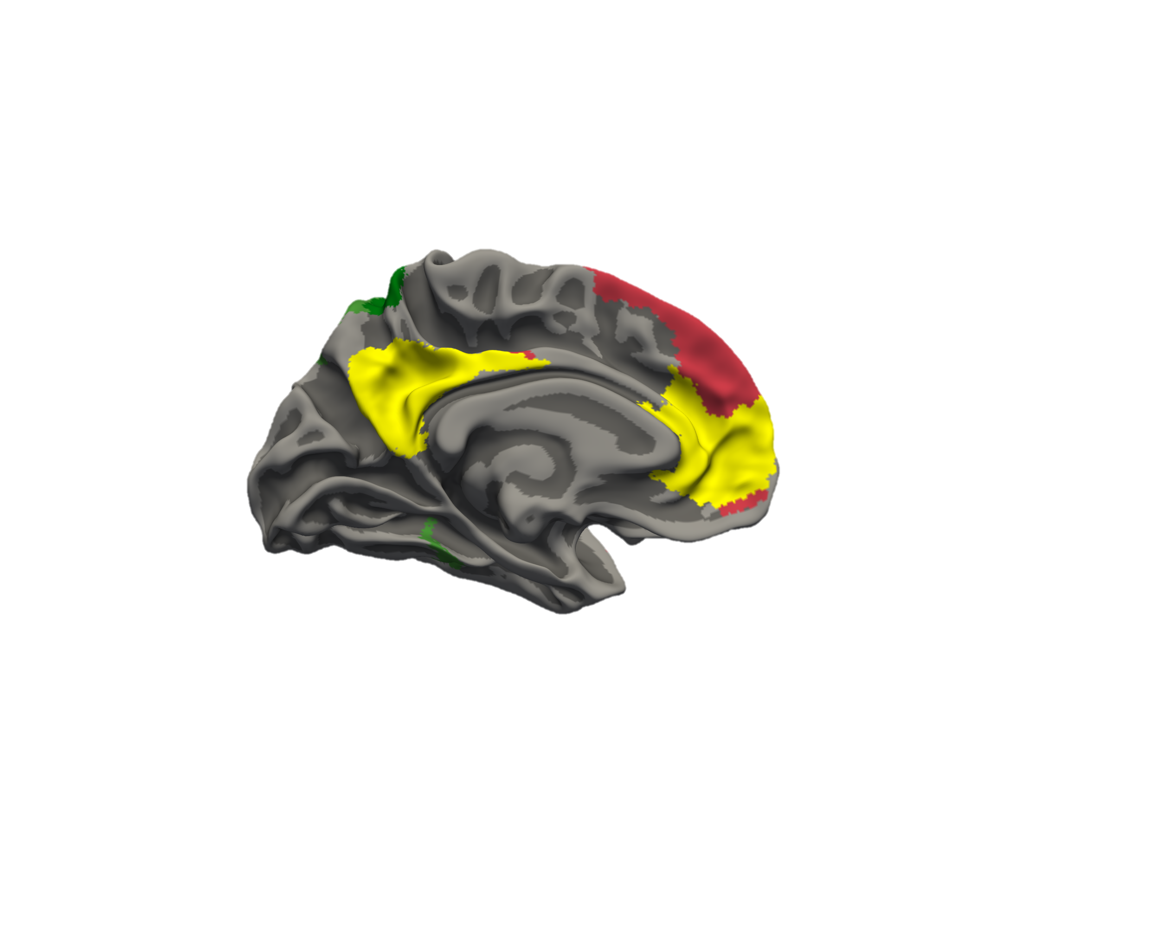
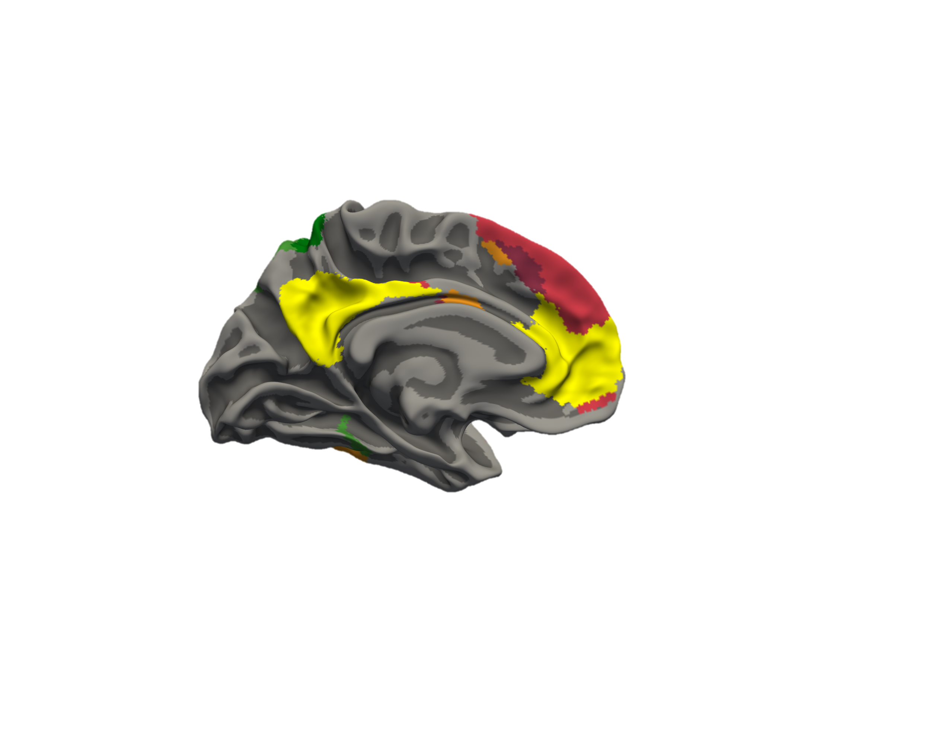
Examining Network Activity Across Symbolic and Perceptual Reasoning
17 Network Parcellation
Yeo et al. 2011
Dorsal Attention
Cognitive Control
Default Mode

Slide 15


Differential Cognitive Control Network Activation
Dorsal Attention
Cognitive Control
Default Mode
Notes:
Color code the x-axis in illustrator to correspond to conditions
Angle slightly off (not vertical)

Slide 16
Symbolic vs. Perceptual Activity Patterns
Symbol
>
Texture
Notes:
Hold off on contrasting symbol vs texture in general until we get here
Put symbol in orange and texture in blue

Slide 17
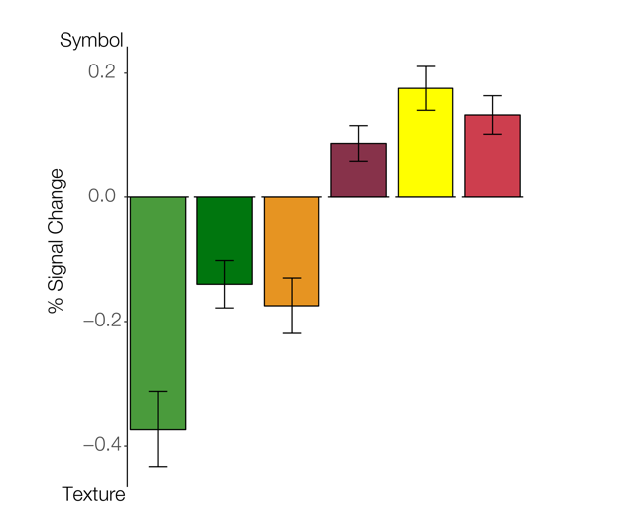
Differential Activation of CCN Subdivisions
Dorsal Attention
Cognitive Control
Default Mode
Notes:
Fix the title here

Slide 18
Implications
Future computational models might consider the additional ventral-visual processing involved in perceptual reasoning
Processing of symbolic stimuli may draw on long-term representations (schemas)
Notes:
Other robotics people focusing on basic perceptual processing a lot… basic perceptual processing vs. reasoning

Slide 19
Future Directions
How does functional connectivity differ between conditions?
What role do subcortical structures play in this task?
Are there separate functions for the various nodes of the frontoparietal control network?

Slide 20
Thank You!
GPN
Shelley Russek
Sandi Grasso
Nazifa Haque
Qualifying Exam Committee
Chantal Stern
Joe McGuire
Mike Hasselmo
Cognitive Neuroimaging Center
Jay Bohland
Shruthi Chakrapani
Stern Lab
Chantal Stern
Allen Chang
Rachel Nauer
Matt Dunne
Stamati Liapis
Kylie Moore
Kelli Tahaney
Tashauna Blankenship
Weida Ma
Sheila Yee
Boston University
David Somers
Funding
NSF Major Research Instrumentation Award 1625552
ONR MURI Award N00014-16-1-2832
ONR DURIP Award N00014-17-1-2304

Slide 21
Response Times

Slide 22
Accuracy
*

Slide 23
Full Yeo 7 Network Analysis
*

Slide 24
Full Yeo-17 Network Analysis
*
*
*
*
*

Slide 25
Sym > Txt Yeo17 Nx ROI Analysis

